Slide 1
The SQL Server 2019 Workshop https://aka.ms/sqlworkshops
Microsoft Azure Data SQL Server Engineering

Slide 2
SQL Server 2019 Workshop Modules
01 In-memory OLTP
02 Columnstore Indexes
03 Always Encryted with secure Enclaves
04 Dynamic Data Masking
05 Data Virtualization with Polybase
06 Intelligent Query Processing
07 Accelerated database recovery
08 Row Level Security

Slide 3
In-Memory OLTP

Slide 4
In-Memory OLTP isn't a magic go-fast button, and isn't suitable for all workloads. For example, memory-optimized tables don't bring down your CPU utilization if most of the queries are performing aggregation over large ranges of data. Columnstore indexes help with that scenario.
In-Memory OLTP
High-throughput and low-latency transaction processing
Data ingestion, including IoT (Internet-of-Things)
Caching and session state.
How bwin is using SQL Server 2016 In-Memory OLTP to achieve unprecedented performance and scale | Microsoft Learn
tempdb object replacement
ETL (Extract Transform Load)
In-Memory OLTP overview and usage scenarios - SQL Server | Microsoft Learn

Slide 5
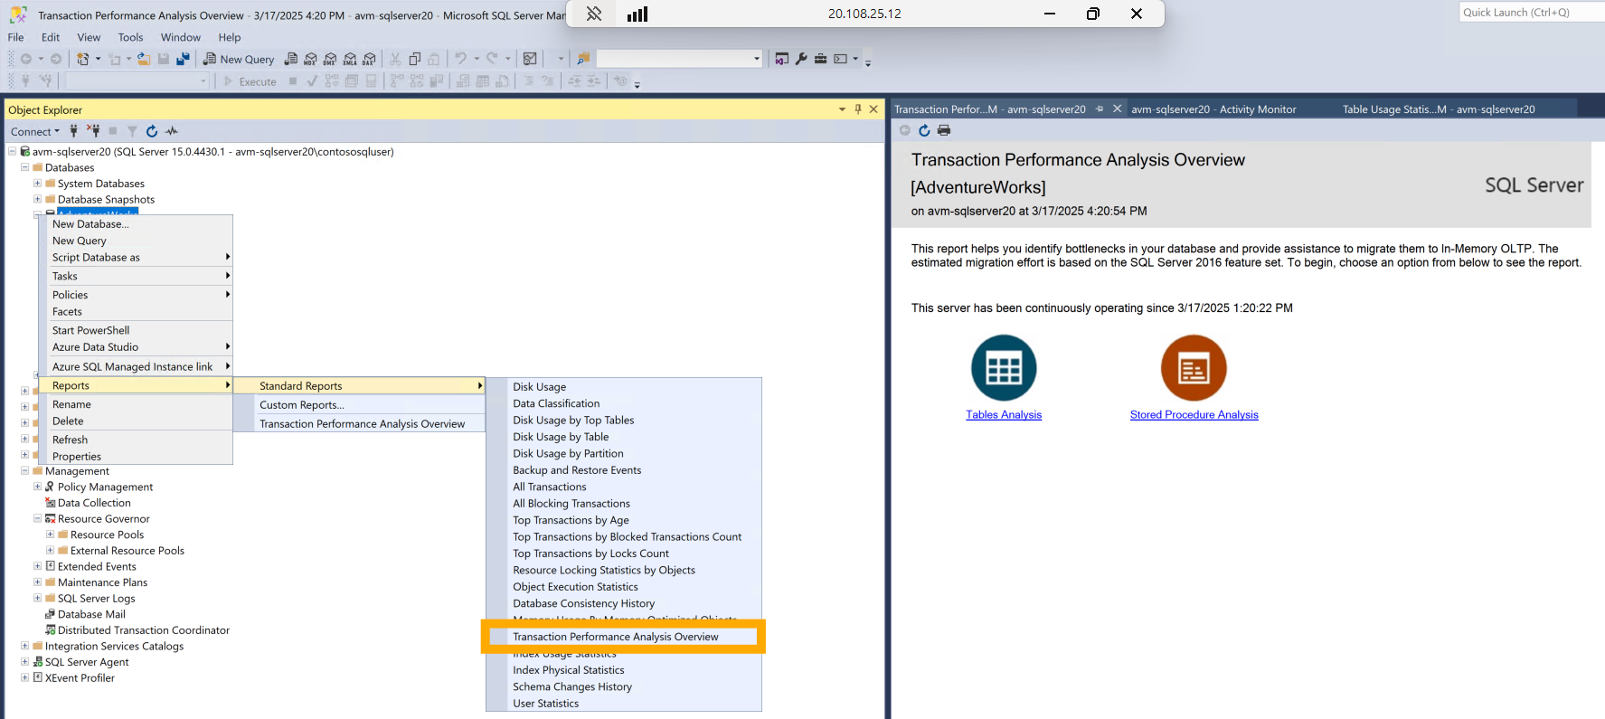
Assessment of objects

Slide 6
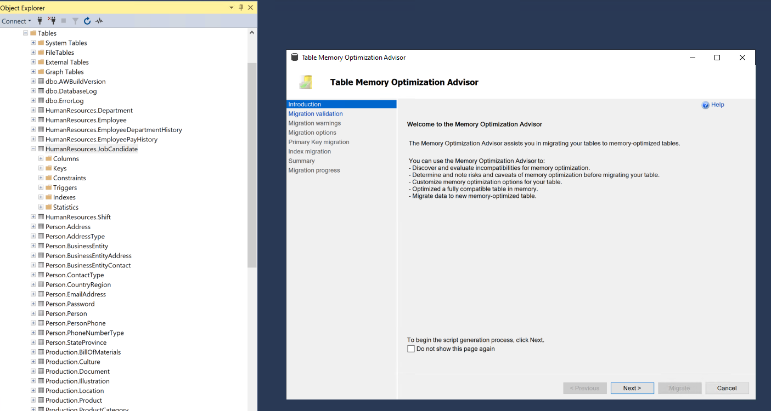
Table Memory Optimization Advisor

Slide 7
In-Memory OLTP Demo

Slide 8
ColumnStore Index

Slide 9
Columnstore Index data requirements
Consider using a clustered columnstore index when:
Each partition has at least a million rows. Columnstore indexes have rowgroups within each partition. If the table is too small to fill a rowgroup within each partition, you might not get the benefits of columnstore compression and query performance.
Queries primarily perform analytics on ranges of values. For example, to find the average value of a column, the query needs to scan all the column values. It then aggregates the values by summing them to determine the average.
Most of the inserts are on large volumes of data with minimal updates and deletes. Many workloads such as Internet of Things (IOT) insert large volumes of data with minimal updates and deletes. These workloads can benefit from the compression and query performance gains that come from using a clustered columnstore index.
Columnstore indexes - Design guidance - SQL Server | Microsoft Learn

Slide 10
Columnstore Index data requirements
Don't use a clustered columnstore index when:
The table requires varchar(max), nvarchar(max), or varbinary(max) data types. Or, design the columnstore index so that it doesn't include these columns (Applies to: SQL Server 2016 (13.x) and previous versions).
The table data is not permanent. Consider using a heap or temporary table when you need to store and delete the data quickly.
The table has less than one million rows per partition.
More than 10% of the operations on the table are updates and deletes. Large numbers of updates and deletes cause fragmentation. The fragmentation affects compression rates and query performance until you run an operation called reorganize, which forces all data into the columnstore and removes fragmentation.
Columnstore indexes - Design guidance - SQL Server | Microsoft Learn

Slide 11
Choose the best columnstore index for your needs
Columnstore option | Recommendations for when to use | Compression
Clustered columnstore index | 1) Traditional data warehouse workload with a star or snowflake schema 2) Internet of Things (IOT) workloads that insert large volumes of data with minimal updates and deletes. | Average of 10x
Ordered columnstore index | Use when a clustered columnstore index is queried via a single ordered predicate column or column set. This guidance is similar to choosing the key columns for a rowstore clustered index, though the compressed underlying rowgroups behave differently. For more information, see CREATE COLUMNSTORE INDEX and Performance tuning with ordered columnstore indexes. | Average of 10x
Nonclustered B-tree indexes on a clustered columnstore index | 1. Enforce primary key and foreign key constraints on a clustered columnstore index. 2. Speed up queries that search for specific values or small ranges of values. 3. Speed up updates and deletes of specific rows. | 10x on average plus some additional storage for the NCIs.
Nonclustered columnstore index on a disk-based heap or B-tree index | 1) An OLTP workload that has some analytics queries. You can drop B-tree indexes created for analytics and replace them with one nonclustered columnstore index. 2) Many traditional OLTP workloads that perform Extract Transform and Load (ETL) operations to move data to a separate data warehouse. You can eliminate ETL and a separate data warehouse by creating a nonclustered columnstore index on some of the OLTP tables. | NCCI is an additional index that requires 10% more storage on average.
Columnstore index on an in-memory table | Same recommendations as nonclustered columnstore index on a disk-based table, except the base table is an in-memory table. | Columnstore index is an additional index.
Columnstore indexes - Design guidance - SQL Server | Microsoft Learn

Slide 12
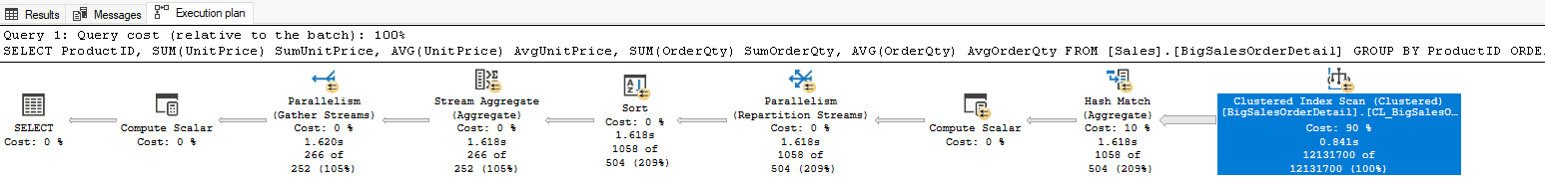
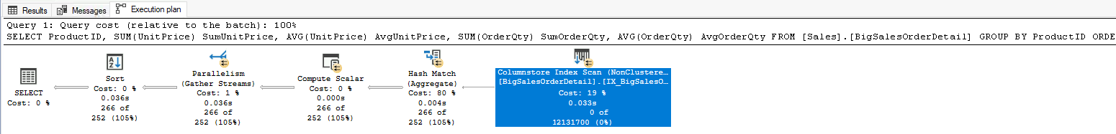
Columnstore index demo
Before Columnstore index
After Columnstore index
Columnstore indexes - Design guidance - SQL Server | Microsoft Learn

Slide 13
ColumnStore Indexes Demo

Slide 14
Always Encrypted with Secure Enclaves

Slide 15
Protecting Data Through its Lifecycle
Existing
New
In transit
Encrypt data that is flowing between applications and the database
TLS
In use
Protect/Encrypt data that is in use during computation
Always Encrypted
At rest
Encrypt inactive data when stored in database files, backup files, log files, etc.
SQL Server Transparent Database Encryption (TDE)
Notes:
Protective sensitive business data is more important today than ever before. Corporate trade secrets, national security information, personal medical records, Social Security and credit card numbers are all stored, used, and transmitted online and through connected devices.
Data needs to be protected in three states: at rest, in use, and in motion. Each state presents unique security challenges.
Data at Rest
Data is at rest when it is stored on a hard drive. In SQL Server/Azure SQL Database, this means data in database files (.mdf), log files (.ldf), backup failes (.bak), bacpac, etc. Either encrypting the entire drive or encrypting particular files by using Transparent Database Encryption (TDE), is one of the best ways to ensure the security of data at rest.
TDE ensures encryption of database files at the page level. The pages in an encrypted database are encrypted before they are written to disk and decrypted when read into memory.
Data in transit
Data is in transit when it is being transmitted between components or tiers of a computer system, either over the public or untrusted network. Specifically, in the database world: when it is being transmitted between a database and a database client. Transport Layer Security (TLS) is a mechanism that is commonly used to protect data in transit
Data in Use
Data in use is data that is stored in a non-persistent memory, CPU caches or registers – in other words, the data used during computations. Most database systems support both encryption at rest and in transit. Always Encrypted encrypts data while in use.

Slide 16
Always Encrypted with secure enclaves
Always Encrypted
Introduced in SQL Server 2016
Protect sensitive data from DBAs, admins, etc.
Data and keys never in clear text in SQL
Queries severely restricted
Only equality comparison (Name = ‘Bill Gates’)
Data must be moved out to…
Rotate keys
Name LIKE ‘Bill G%’
Always Encrypted with secure enclaves
Computations on server side
Computations inside a secure enclave
Secure Enclave – protected region in memory
Cannot be view, even with a debugger
In-place encryption
Range and pattern operations
Salary > 1,000,000
Name LIKE ‘Bill G%’
Notes:
Introduced in SQL Server 2016, Always Encrypted protects the confidentiality of sensitive data from malware and high-privileged unauthorized users of SQL Server. High-privileged unauthorized users are DBAs, computer admins, cloud admins, or anyone else who has legitimate access to server instances, hardware, etc., but who should not have access to some or all of the actual data.
Always Encrypted protects the data by encrypting it on the client side and never allowing the data or the corresponding cryptographic keys to appear in plaintext inside the SQL Server Engine. As a result, the functionality on encrypted columns inside the database is severely restricted. The only operations SQL Server can perform on encrypted data are equality comparisons (and only available on columns with deterministic encryption). All other operations, including cryptographic operations (initial data encryption or key rotation) and or rich computations (for example, pattern matching) are not supported inside the database. Users need to move their data outside of the database to perform these operations on the client-side.
Always Encrypted with secure enclaves addresses these limitations by
allowing computations on plaintext data inside a secure enclave on the server side.
A secure enclave is a protected region of memory within the SQL Server process, and acts as a trusted execution environment for processing sensitive data inside the SQL Server engine. A secure enclave appears as an opaque box to the rest of the SQL Server and other processes on the hosting machine.
There is no way to view any data or code inside the enclave from the outside, even with a debugger.
For In-place encryption - cryptographic operations on sensitive data, for example: initial data encryption or rotating a column encryption key, are performed inside the secure enclave and do not require moving the data outside of the database.
Now we can perform rich computation - operations on encrypted columns, including pattern matching (the LIKE predicate) and range comparisons, are supported inside the secure enclave, which unlocks Always Encrypted to a broad range of applications and scenarios that require such computations to be performed inside the database system.

Slide 17
The operations supported inside the secure enclaves are:
Operation | Azure SQL Database | SQL Server 2022 (16.x) | SQL Server 2019 (15.x)
Comparison Operators | Supported | Supported | Supported
BETWEEN (Transact-SQL) | Supported | Supported | Supported
IN (Transact-SQL) | Supported | Supported | Supported
LIKE (Transact-SQL) | Supported | Supported | Supported
DISTINCT | Supported | Supported | Supported
Joins | Supported | Supported | Only nested loop joins supported
SELECT - ORDER BY Clause (Transact-SQL) | Supported | Supported | Not supported
SELECT - GROUP BY- Transact-SQL | Supported | Supported | Not supported
In SQL Server 2019 (15.x), confidential queries using enclaves on a character string column (char, nchar) require the column uses aa_BIN2 collation is required.
Notes:
Protective sensitive business data is more important today than ever before. Corporate trade secrets, national security information, personal medical records, Social Security and credit card numbers are all stored, used, and transmitted online and through connected devices.
Data needs to be protected in three states: at rest, in use, and in motion. Each state presents unique security challenges.
Data at Rest
Data is at rest when it is stored on a hard drive. In SQL Server/Azure SQL Database, this means data in database files (.mdf), log files (.ldf), backup failes (.bak), bacpac, etc. Either encrypting the entire drive or encrypting particular files by using Transparent Database Encryption (TDE), is one of the best ways to ensure the security of data at rest.
TDE ensures encryption of database files at the page level. The pages in an encrypted database are encrypted before they are written to disk and decrypted when read into memory.
Data in transit
Data is in transit when it is being transmitted between components or tiers of a computer system, either over the public or untrusted network. Specifically, in the database world: when it is being transmitted between a database and a database client. Transport Layer Security (TLS) is a mechanism that is commonly used to protect data in transit
Data in Use
Data in use is data that is stored in a non-persistent memory, CPU caches or registers – in other words, the data used during computations. Most database systems support both encryption at rest and in transit. Always Encrypted encrypts data while in use.

Slide 18
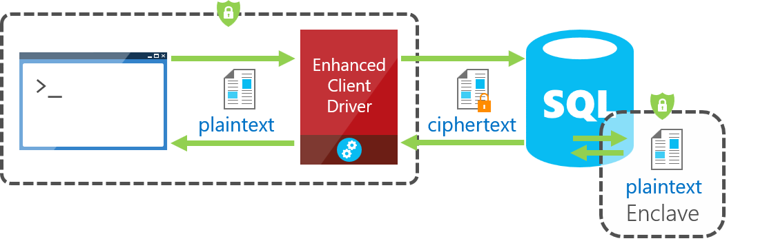
Always Encrypted using secure enclaves
Notes:
When parsing an application's query, the SQL Server Engine determines if the query contains any operations on encrypted data that require the use of the secure enclave. For queries where the secure enclave needs to be accessed:
The client driver sends the column encryption keys required for the operations to the secure enclave (over a secure channel).
Then, the client driver submits the query for execution along with the encrypted query parameters.
During query processing, the data or the keys are not exposed in plaintext in the SQL Server Engine, only in the secure enclave. The secure enclave decrypts the parameters and the data stored in encrypted columns and performs the requested operations.

Slide 19
Using secure enclaves
Permissions for querying encrypted columns
To run any queries against encrypted columns, including queries that retrieve data in ciphertext, you need the VIEW ANY COLUMN MASTER KEY DEFINITION and VIEW ANY COLUMN ENCRYPTION KEY DEFINITION permissions in the database.
Security considerations
If you use Always Encrypted to protect sensitive data from unauthorized access by DBAs, don't share the column master keys or column encryption keys with the DBAs. A DBA can manage indexes on encrypted columns without having direct access to the keys by using the cache of column encryption keys inside the enclave..
Query columns using Always Encrypted with SQL Server Management Studio - SQL Server | Microsoft Learn
Always Encrypted with secure enclaves - SQL Server | Microsoft Learn
Query columns using Always Encrypted with SQL Server Management Studio - SQL Server | Microsoft Learn
Notes:
Here is a simple example from someone like a DBA running a query Management Studio. You can see the encrypted values on these columns. This is because this user did not connect to the database with a driver that could decrypt.

Slide 20
Always Encrypted with secure Enclave Demo

Slide 21
Dynamic Data Masking

Slide 22
What is Dynamic Data Masking
Dynamic Data Masking (DDM) is a security feature in databases that hides sensitive data in real-time to prevent unauthorized access.
It works by showing only a masked version of the data to users who don't have permission to see the full details, while authorized users can see the actual data.

Slide 23
Why Dynamic Data Masking
Helps prevent unauthorised access to sensitive data by enabling user to specify how much sensitive data to reveal.
Easy and cost-effective way to implement masking in the database.
Masking rules are applied on the query results before it is sent to client application Underlying data in the database remains unchanged

Slide 24
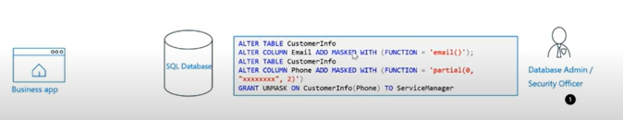
Dynamic Data Masking In Action
1. Security officer/ DBA defines Dynamic Data Masking policy/function on the sensitive columns in the database.

Slide 25
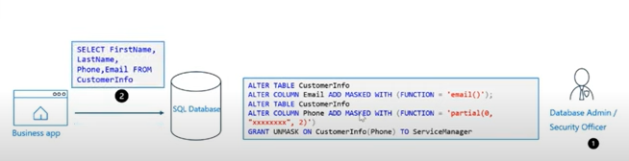
2. Business user fetches data from the Employee table through the application:

Slide 26
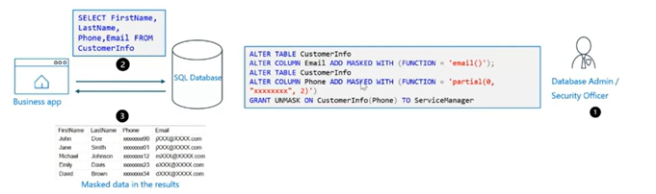
3. Database engine obfuscate the sensitive data in the query results before sending it to application:
https://learn.microsoft.com/en-us/sql/relational-databases/security/dynamic-data-masking?view=sql-server-ver15

Slide 27
Dynamic Data Masking Demo

Slide 28
Data Virtualization with Polybase

Slide 29








Remove data silos with Polybase
Challenge
Integrating data from numerous data silos is complex with traditional ETL methods
Solution
Access from multiple sources without moving data
Integrate data with data virtualization
T-SQL language with external tables
Distributed/scalable performance with Polybase
T-SQL
…
ODBC
NoSQL
Relational databases
Big Data
Azure Cosmos DB
Excel
Intelligence over any data

Slide 30

What is SQL Server Polybase?
“It’s all about
Data Virtualization”
It all started with T-SQL against Hadoop
Query data where it lives using T-SQL
Compute engine integrated with SQL Server
Distributed, scalable query performance
Manual/deploy with SQL Server
Auto deploy/optimize with Big Data Clusters
Analytics
T-SQL
Apps
SQL Server
PolyBase external tables
ODBC
NoSQL
Relational databases
Big data
Cosmos DB
HDFS
Intelligence over all data

Slide 31
Using Polybase in SQL Server: T-SQL EXTERNAL TABLE
Login and password
Only for HDFS
Setup and configure Polybase
Setup authentication
Create EXTERNAL DATA SOURCE
Create EXTERNAL FILE FORMAT
Create EXTERNAL TABLE
Create statistics on key columns
Query like any other table
Not simple without BDC
And join to any other table or external table
metadata
WWI
Results streamed
HDFS
SQL
Data lives
here
INSERT only for HDFS
Cosmos DB

Slide 32
External Tables vs Linked Servers
External Tables
Database Scoped
ODBC Drivers
Linked Servers
Instance Scoped
OLEDB Providers
Read-only*
Single threaded queries with push-down
Scale out queries with push-down
Failover with AG
Requires separate config from AG
Basic authentication
Basic and integrated authentication
Distributed Transactions not supported
Distributed Transactions supported
Read/write
* Insert into HDFS allowed

Slide 33
The SQL Server Polybase Architecture
control and
execution
Data flow
EE only
All editions
All editions
“Head” node
“Compute” node
“Compute” node
DW dbs
SQL Engine
DW dbs
SQL Engine
DW dbs
SQL Engine
tempdb
tempdb
tempdb
Need more scale?
Add compute nodes
Polybase Engine
Polybase Engine
Polybase Engine
……...
Polybase Data Movement Service
Polybase Data Movement Service
Polybase Data Movement Service
Scan or pushdown
Scale out with partitions
shuffle
mpdwsvc.exe
Your data sources
Cosmos DB
HDFS

Slide 34

SQL Server 2019 serves as the hub for all your data
Legacy SQL Server
Azure SQL Database
Azure Cosmos DB
Legacy suppliers
Modern stock items
Mobile app orders
SQL Server 2019
Customers from acquisition
Accounts receivable
Order reviews
Intelligence over any data
Notes:
This is a great example for a company that has existing data sources but doesn’t want to or cannot move the data.

Slide 35
Using Polybase with SQL Server 2019 Demo microsoft/sqlworkshops-sql2019lab: SQL Server 2019 Lab

Slide 36
Intelligent Query Processing

Slide 37

Industry leading performance
Intelligent Database
Challenge
DBA’s spend most of their time tuning database performance, leading to high operational costs
Solution
Automation with Intelligent Database capabilities while providing mission critical performance
Gain performance with no app changes with Intelligent Query Processing
Performance insights anytime anywhere with Query Store and lightweight query profiling
Accelerate I/O performance with Persistent Memory
Performance
Improves performance with no app change
App
Persistent Memory
Query Store
Intelligent Query Processing improved Banco Itau’s query performance by 92% without the need for any code changes
Intelligent performance

Slide 38
Gain performance without changing the application
The Intelligent Query Processing feature family
Intelligent QP
Adaptive QP
Table Variable Deferred Compilation
Batch Mode for Row Store
Approximate QP
Scalar UDF inlining
Intelligent Query Processing
Sequential Key Insert Performance
In-Memory technologies
Hybrid Buffer Pool
Persistent Memory Support
Memory-Optimized TempDB Metadata
Adaptive Joins
Interleaved Execution
Memory Grant Feedback
Approximate Count Distinct
Batch Mode
Batch Mode
Row Mode
Intelligent performance
Bold indicates new and improved features in SQL Server 2019

Slide 39
Intelligent Query Processing
dbcompat to enable
140 | SQL Server 2017
150 | SQL Server 2019
The problem
Build a query processor to work and adapt to any type of workload with no application changes required
The Solution(s)
Build intelligent, adaptable operators
Modify query plans in cache based on previous execution
Expand batch mode
Execution data drives downstream compilation
Smarter query processing
Feature Suite
Adaptive Join
140
140
150
Memory Grant Feedback for Batch and Row
Batch Mode for Row Store
150
Interleaved Execution
Table Variable Deferred Compilation
140
150
Approximate Count Distinct
Scalar UDF Inling
150
Notes:
2 mins

Slide 40
Tempdb Just Runs Faster
The problem(s)
High multi-user rates of tempdb usage can lead to latency due to….
allocation page latch waits – Multiple users needing to allocate pages for temp tables
system table page latch waits – High rates of create/drop require system table modifications
The Solution
Create multiple files to partition allocation pages
SQL Server 2016+ creates multiple tempdb files during setup
Start with 8 and add by 4 until concurrency alleviated
But…what about system tables?
The SQL 2019 Solution
Key tempdb system tables become SCHEMA_ONLY memory optimized tables
Latch and lock free
Turn on with ALTER SERVER CONFIGURATION
This is NOT user data just metadata so memory requirements small

Slide 41
Intelligent Query Processing Demo microsoft/sqlworkshops-sql2019lab: SQL Server 2019 Lab

Slide 42
Accelerated Database Recovery

Slide 43
SQL Server is always available
The New Recovery Process with ADR
Oldest uncommitted Tx (XACT_BEGIN_LSN)
Last checkpoint (or oldest dirty page LSN)
End of log
Challenge
Log Grows out of Control
Long rollback blocks applications
Long Recovery prolongs downtime
Index operations resource intensive
Solution
Accelerated Database Recovery (ADR)
Online Index enhancements
Availability group enhancements
Phase 1: Analysis
Phase 2: Redo from sLog
Phase 2: Redo
Phase 3: Undo from sLog
sLog is persisted to disk as part of checkpoint
Only this portion of the Transaction Log is scanned.
Transaction Log
Start of log
sLog
Log records for non-versioned ops are copied to sLog
Bank achieves high availability of mission critical data thanks to Accelerated Database Recovery
Mission critical high availability
Notes:
Space out the Challenge and Solution sections better

Slide 44

Accelerated Database Recovery (ADR)
Read the paper
How it works
Enable/disable as a database option
Uses a Persisted Version Store (PVS)
Independent of locking and isolation levels
Rollback faster than you can react
Undo recovery faster than you can look it up
Transaction log truncation not tied to active transactions
Key questions :
Will my database be larger with the PVS?
It will be larger than without ADR. However, it may not grow extremely large due to concepts like logical revert and cleanup processes designed with ADR. Testing is the only way to know but the paper has some observations from the engineering team.
Will it affect performance?
As with any feature performance impact will vary. However, extremely "write-heavy" applications may see some effect. Typically those applications don't use long running transactions so they may not benefit from ADR. The paper has testing observations using benchmarks derived from TPC.
How is the Persistent Version Store different than the Version Store in TempDB?
SQL Server uses TempDB to store versions for rows for queries that use SNAPSHOT transaction isolation levels (or the database option READ_COMMITTED_SNAPSHOT_ISOLATION). If you enable ADR for a database, any queries using SNAPSHOT transaction isolation levels will use the persistent version store instead.
How does this affect Always On Availability Groups?
Secondary replicas receive all changes to the persistent version store and log records. ADR can help speed up failover times because undo processing can be extremely fast. In addition read-only queries on secondary replicas will now use the persistent version store instead of TempDB on the secondary. Secondary replicas signal the primary replica which versions need to be kept to service read queries on secondaries. If a secondary replica needs to be restarted, the persistent version store can easily be used where as with TempDB, the version store is lost and read queries may be held up for transactions to commit or undo.
Accelerated Database Recovery powers Azure SQL Database Hyperscale
Mission critical high availability
Notes:
Format and separate the two sections

Slide 45
Questions about ADR
Will my database be larger with the PVS?
It will be larger than without ADR. However, it may not grow extremely large due to concepts like logical revert and cleanup processes designed with ADR. Testing is the only way to know.
Will it affect performance?
As with any feature performance impact will vary. However, extremely "write-heavy" applications may see some effect. Typically those applications don't use long running transactions so they may not benefit from ADR.
How is the Persistent Version Store different than the Version Store in TempDB?
SQL Server uses TempDB to store versions for rows for queries that use SNAPSHOT transaction isolation levels (or the database option READ_COMMITTED_SNAPSHOT_ISOLATION). If you enable ADR for a database, any queries using SNAPSHOT transaction isolation levels will use the persistent version store instead.
How does this affect Always On Availability Groups?
Secondary replicas receive all changes to the persistent version store and log records. ADR can help speed up failover times because undo processing can be extremely fast. In addition read-only queries on secondary replicas will now use the persistent version store instead of TempDB on the secondary. Secondary replicas signal the primary replica which versions need to be kept to service read queries on secondaries. If a secondary replica needs to be restarted, the persistent version store can easily be used where as with TempDB, the version store is lost and read queries may be held up for transactions to commit or undo.
Notes:
Format and separate the two sections

Slide 46
Accelerated Database Recovery demo microsoft/sqlworkshops-sql2019lab: SQL Server 2019 Lab

Slide 47

Row Level Security
Row-level security - SQL Server | Microsoft Learn

Slide 48
Description
Row-level security (RLS) enables you to use group membership or execution context to control access to rows in a database table.
Row-level security simplifies the design and coding of security in your application. RLS helps you implement restrictions on data row access. For example, you can ensure that workers access only those data rows that are pertinent to their department. Another example is to restrict customers' data access to only the data relevant to their company.
The access restriction logic is located in the database tier rather than away from the data in another application tier. The database system applies the access restrictions every time that data access is attempted from any tier. This makes your security system more reliable and robust by reducing the surface area of your security system.
Row Level Security is built into the core SQL Server query engine, which means the setup and ongoing administration is much easier than row based security has ever been in the past. An administrator can apply security to a series of objects, by specifying the rules on which access is granted in a series of functions. More importantly, a function can be applied to multiple objects.
This creates consistency for the developer in that the security is always applied without any burden to ensure that T-SQL code checks for access. The developer can write code as if they have access to all rows, and the final implementation will ensure that each time a query attempts to access a table with a security policy applied, the limitations are enforced.

Slide 49
Best practices
It's highly recommended to create a separate schema for the RLS objects: predicate functions, and security policies. This helps to separate the permissions that are required on these special objects from the target tables. Additional separation for different policies and predicate functions might be needed in multitenant databases, but not as a standard for every case.
The ALTER ANY SECURITY POLICY permission is intended for highly privileged users (such as a security policy manager). The security policy manager doesn't require SELECT permission on the tables they protect.
Avoid type conversions in predicate functions to avoid potential runtime errors.
Avoid recursion in predicate functions wherever possible to avoid performance degradation. The query optimizer will try to detect direct recursions, but isn't guaranteed to find indirect recursions. An indirect recursion is where a second function calls the predicate function.
Avoid using excessive table joins in predicate functions to maximize performance.

Slide 50
Cross-feature compatibility
A table can only be referenced by one security policy at a time. This does not include disabled (STATE=OFF) policies, but limits enabled (STATE = ON) policies to one per table. There can be different predicates on the same table (FILTER and BLOCK), but only one of each type at a time can be enabled.
Memory-Optimized Tables: The inline table-valued function used as a security predicate on a memory-optimized table must be defined using the WITH NATIVE_COMPILATION option.
Indexed views: In general, security policies can be created on top of views, and views can be created on top of tables that are bound by security policies. However, indexed views can't be created on top of tables that have a security policy, because row lookups via the index would bypass the policy.
Full-Text Search: A performance hit is expected for queries using the following Full-Text Search and Semantic Search functions, because of an extra join introduced to apply row-level security and avoid leaking the primary keys of rows that should be filtered: CONTAINSTABLE, FREETEXTTABLE, semantickeyphrasetable, semanticsimilaritydetailstable, semanticsimilaritytable.
Columnstore Indexes: RLS is compatible with both clustered and nonclustered columnstore indexes. However, because row-level security applies a function, it's possible that the optimizer might modify the query plan so that it doesn't use batch mode.
Partitioned Views: Block predicates can't be defined on partitioned views, and partitioned views can't be created on top of tables that use block predicates. Filter predicates are compatible with partitioned views.
Temporal tables: Temporal tables are compatible with RLS. However, security predicates on the current table aren't automatically replicated to the history table. To apply a security policy to both the current and the history tables, you must individually add a security predicate on each table.

Slide 51
Row Level Security demo microsoft/sqlworkshops-sql2019lab: SQL Server 2019 Lab

Slide 52
Wrap-up and Q&A

